Slide 1
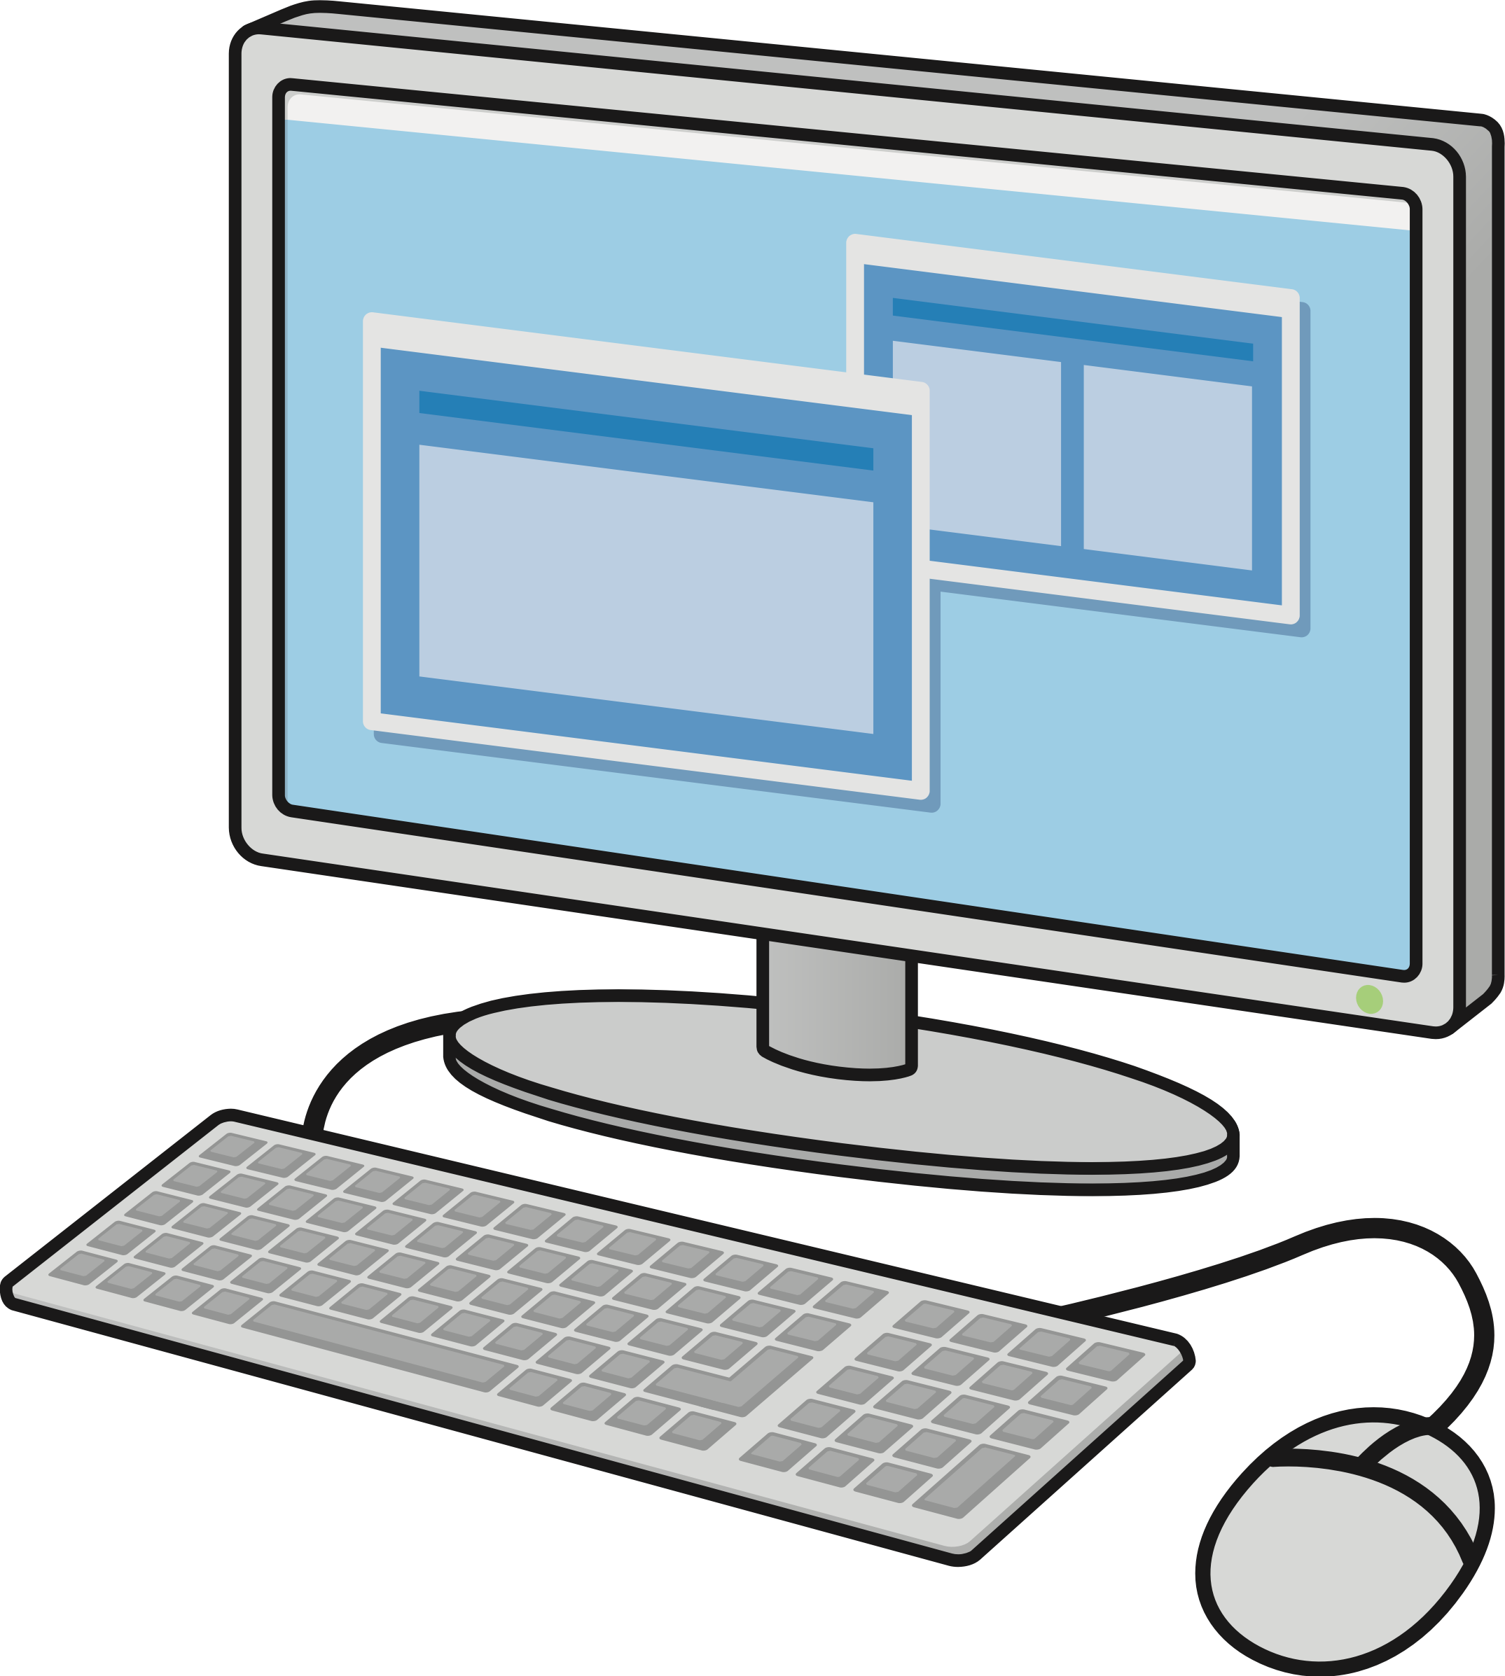
INTRODUCTION OF COMPUTERS

Slide 2
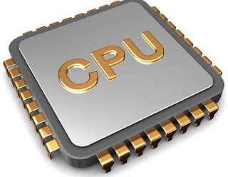
CONTROL PROCESSING SYSTEM
A central processing unit also called a central processor, main processor or just processor is the electronic circuit that execute instructions.
The CPU performs basic arithmetic logic controlling and input/output operations specified by the instructions

Slide 3
DESCRIBING OF A COMPUTER SYSTEM
A computer system is a set of integrated devices that input, output, process, and store the data and information.
Computer systems are currently build around at one digital processing device.
There are five main hardware computer system
1. Input
2. Processing
3. Storage
4. Output

Slide 4
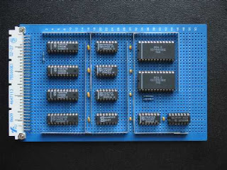
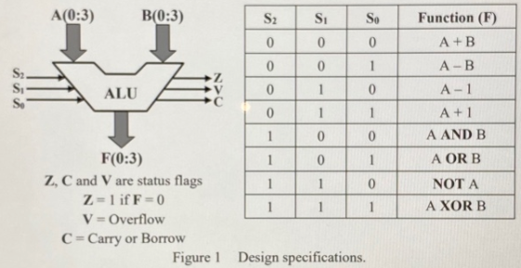
ARITHMETIC LOGIC UNIT
ALU is a main controlling component of central processing unit , which stands for arithmetic logic unit.
It performs arithmetic and logic operations.
It has ability to perform all processes related to arithmetic and logic operations such as addition , subtraction and shifting operations including Boolean compare ( XOR, OR, AND, NOT OPERATIONS.

Slide 5
CLASSIFICATON OF COMPUTERS
1. Super computers
2. Mainframe computers
3. Mini computers
4. Micro computers

Slide 6
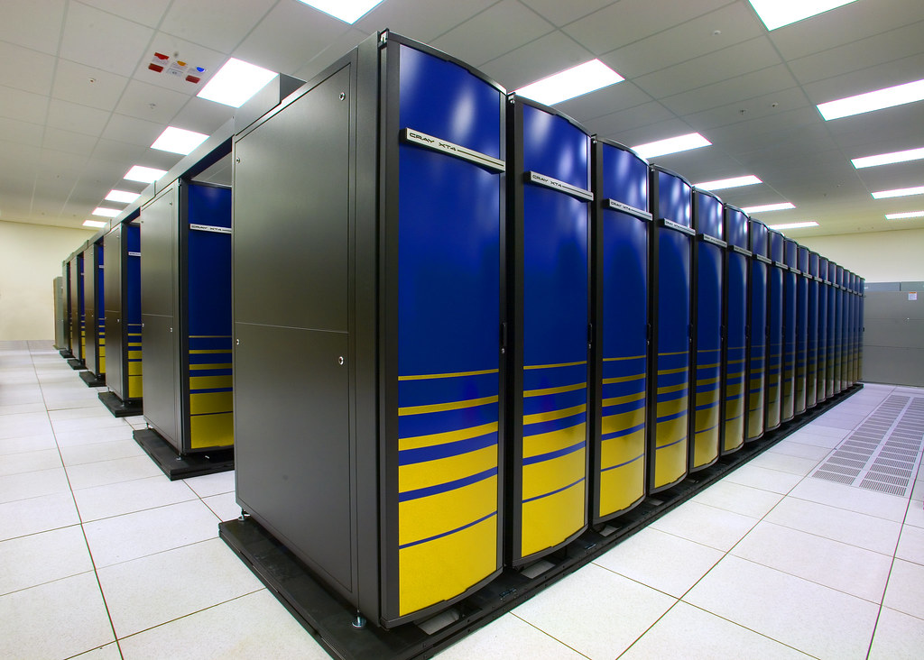
SUPER COMPUTERS
Super computers are the fastest , largest most expensive and also most powerful computers available.
CHARACTERSTICS
Fastest computer
Largest in size
Most expensive
Very heavy

Slide 7
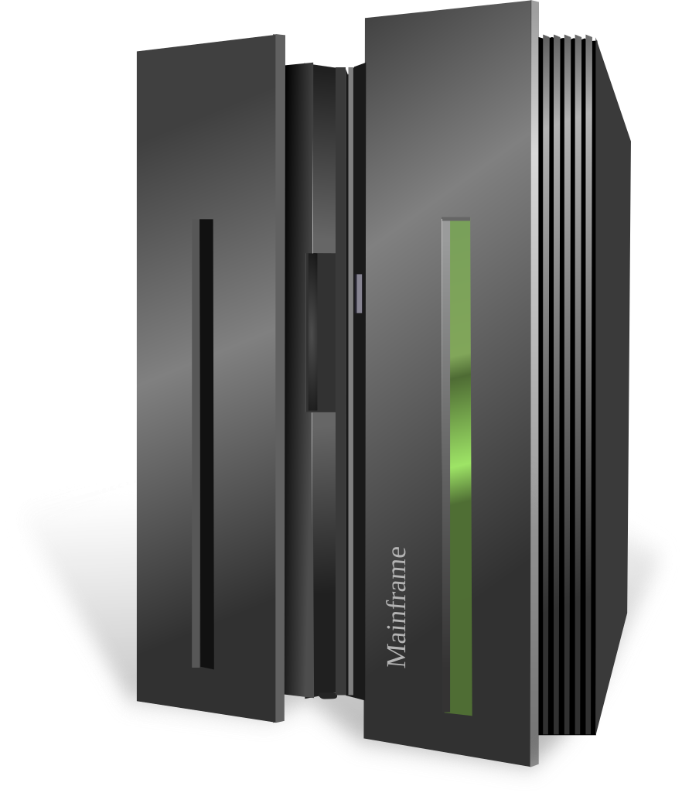
MAIN FRAME COMPUTERS
Main frame computers are less powerful and less expensive than super computers.
Main frames executes many programs concurrently and supports many simultaneous execution of programs.
They are mostly found in government and big organization such as banks, hospitals, airports etc.

Slide 8
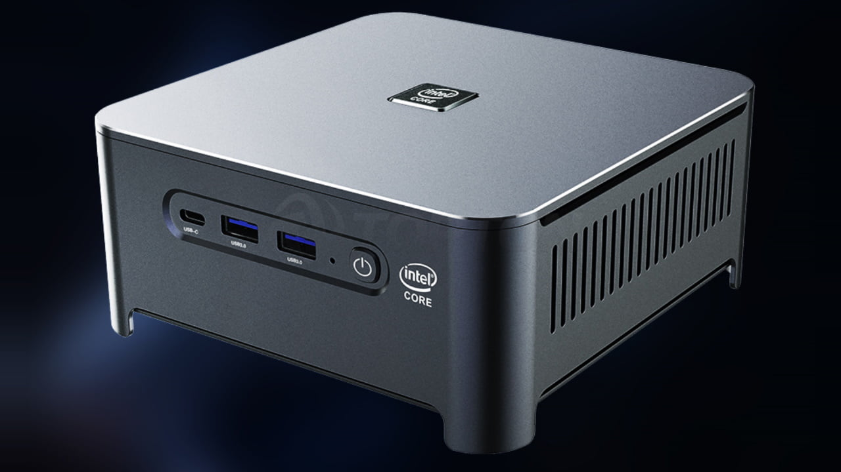
MINI COMPUTERS
A mini computer is physically smaller than a main frame. However it can support the same peripheral devices supported by a main frame.
1. Used in scientific laboratories
2. Used in research institution
3. Engineering plants
4. Automatic processing

Slide 9
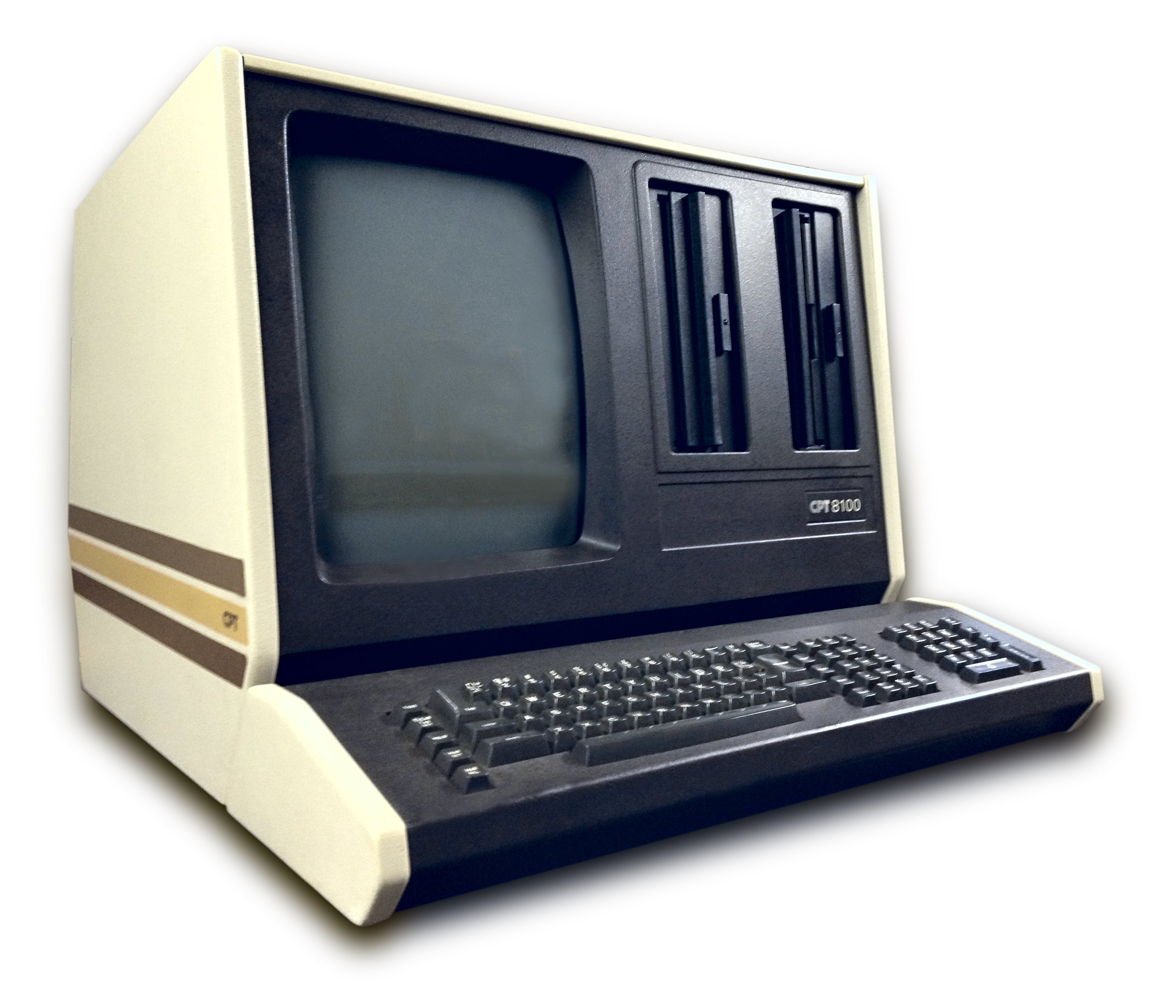
MICRO COMPUTERS
Micro computers are the pc mostly found today in homes school and many small offices. They are called personal computers because they are designed to be used for one person at a time.
CHARACTERSTICS
1. Are cheaper
2. Are very fast

Slide 10
AREAS WHERE COMPUTER IS USED
Training and learning institutions such as school , college , universities.
Small business enterprises
Communication centers as terminals
The following are the various type of micro computers in operation today arranged in descending order according to size.
Desktop computer : it is designed to be placed on top of the office disk.
Notebook or Laptop : portable convenient for mobile users.
Personal Digital Assistance : is small enough to fit in the pocket.

